Slide 1
Advanced Games Engine Creation
Lecture 6
Colours and Lighting

Slide 2
Introduction
This lecture we will
discuss lights and colours
learn how to specify lights and materials in OpenGL

Slide 3
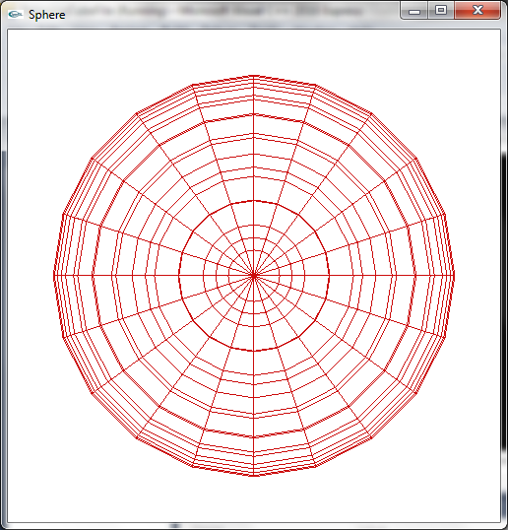
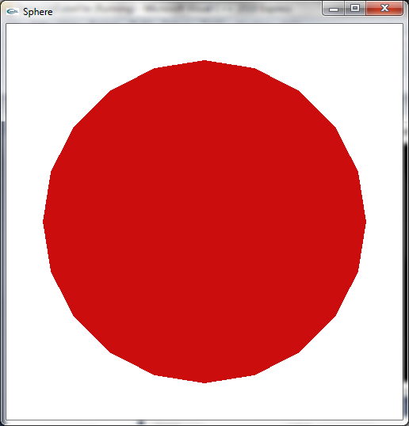
Introduction
so far we in OpenGL we have simply specified a drawing colour
in solid fill mode our objects look flat
this should be a sphere with 20 slices and 20 stacks

Slide 4
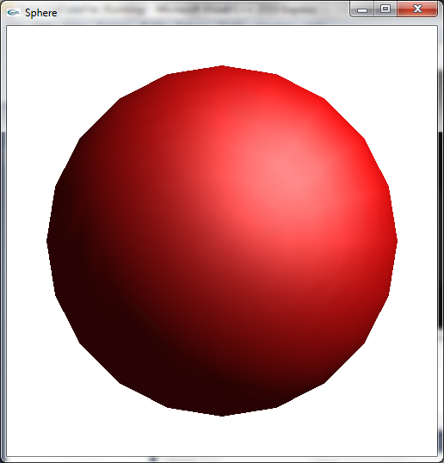
Lighting
in real life a coloured 3D object doesn’t look flat
we see different shades
some brighter where the light hits the object
some darker where it is in shadow
the shading comes from interaction of light with the object

Slide 5
Lights and Colours
there can be several light sources in a scene
a window
lamps
spotlights
fires, indicator lights, toasters….
when light falls on an object
some of it is absorbed
some is reflected or scattered
this light will then fall on other objects…
some of this light reaches our eyes
its colour depends in
the original light colour
the colours absorbed as it hits each object

Slide 6
OpenGL lighting model
to accurately model all the light sources and all the interactions of the light with the scene would involve a lot of calculations
too time-consuming to do in real time
OpenGL uses a fairly simple approximation
the scene has one or more lights
each of which has a colour (r, g, b, a) and a position/direction
and can be turned off and on
each object has a material
which specify what fraction of the light that hits it is scattered / reflected
specified by (r, g, b, a) components
the colour of each object is determined by the interaction of its material with all the lights

Slide 7
Light components
in OpenGL light is considered to be divided into four components
emissive
specular
diffuse
ambient

Slide 8
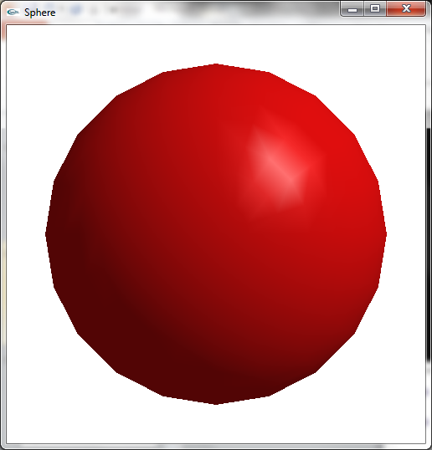
Example -ball lit with specular, diffuse and ambient light components

Slide 9
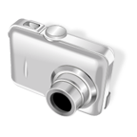
Light components
N
V
L
R
P
in calculating the contribution from each component, four vectors (directions) are important
all relative to a point on the surface P
L – vector from P to the light source
V – vector from P to the viewer (camera)
N - surface normal - vector perpendicular to the surface at P
R – direction of perfect reflection of the light
can be calculated from L and N

Slide 10
Emissive light
N
V
P
emissive light is the light coming from a scene object
window, lamp, toaster, fire….
need to specify a colour
intensity does not depend on the angle from which it is viewed
independent of N and V
doesn't act like a real light source (contribute to the scene illumination)
to do this, specify an (invisible) light at the same position

Slide 11
Specular light
N
V
N
L
R
P
light reflected from a smooth, polished surface
greatest intensity in direction R
a circular highlight
intensity of light reaching the viewer depends on the angle between R and V
the shinier the material, the more concentrated the highlight
specify with a shininess coefficient

Slide 12
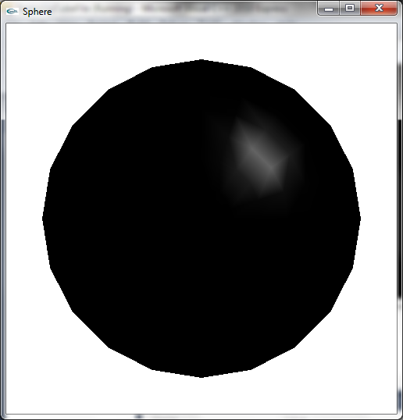
Specular only

Slide 13
Diffuse light
N
N
L
R
P
light striking the surface from a given direction
The sun, a window…
it is partly absorbed by the surface
and partly scattered (reflected) equally in all directions
the reflected light intensity doesn't depend on the view direction (V)

Slide 14
Diffuse light
R
L
N
N
P
the reflected light intensity depends on the angle between the light source and the surface
highest when L is the same direction as the surface normal N
Directly overhead

Slide 15
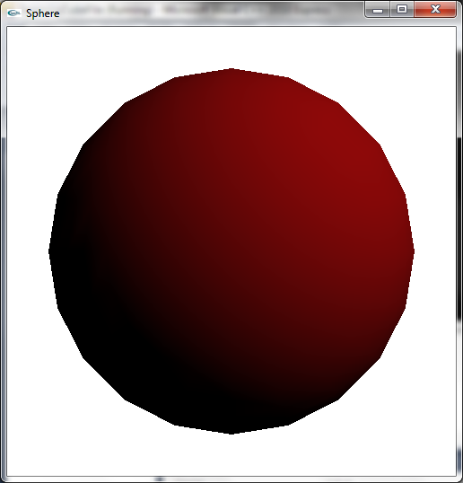
Diffuse only

Slide 16
Ambient light
N
V
P
light coming from all directions
this is the light that has bounced off many scene objects so its original source is unknown
it is scattered equally in all directions
so the intensity depends only on
the ambient light intensity
the properties of the surface (how much ambient light it absorbs/scatters)

Slide 17
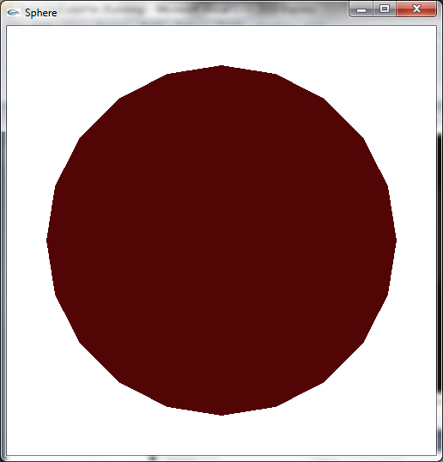
Ambient only

Slide 18
Light components
each light component has an RGBA colour
A for transparancy – alpha
0 is transparent, 1 is opaque
not really relevant to lights so set to 1
the colours can be the same for all components, or different
a white light shining in a red room could have white diffuse and specular components, and pink ambient
a backlight in a room has a large ambient component
a spotlight outdoors has a small ambient component

Slide 19
Object materials
the object materials specify the fractions of the ambient, diffuse and specular light components reflected/scattered by it
rather than absorbed
a red ball absorbs most of the blue and green ambient and diffuse light hitting it
and scatters most of the red ambient and diffuse light
if the ball is shiny, it will also a reflect a lot of the specular light
this will normally be the colour of the light source’s specular component
because the surface is not absorbing any light
material specular component should be grey or white

Slide 20
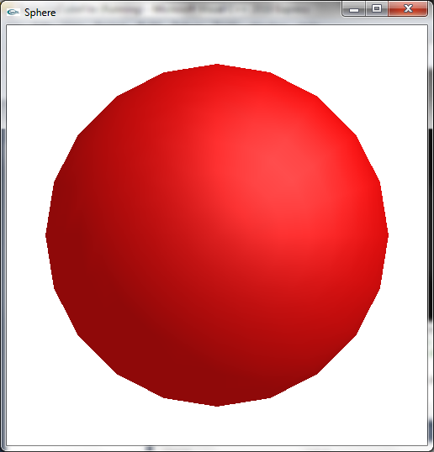
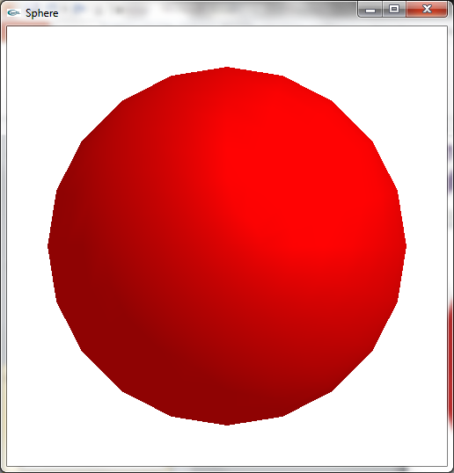
A red ball in red light
A red ball in white light

Slide 21
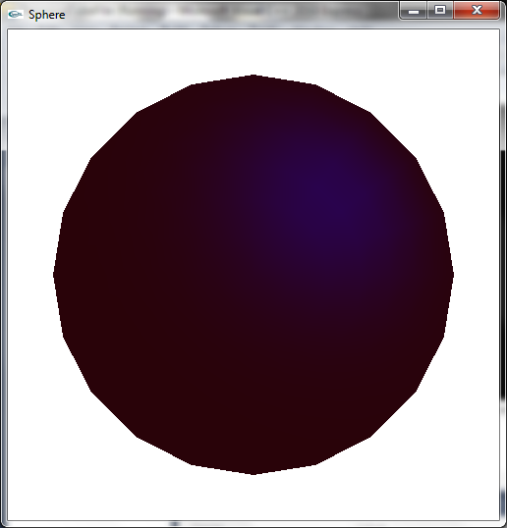
A red ball in blue light
ball materials:
material redDullMaterial = {
{0.80, 0.05, 0.05, 1.0},
{0.80, 0.05, 0.05, 1.0},
{0.5, 0.5, 0.5, 1.0},
10.0
};
light colours:
lighting blueLighting = {
{0.0, 0.0, 0.5, 1.0},
{0.0, 0.0, 0.5, 1.0},
{0.0, 0.0, 0.5, 1.0}
};

Slide 22
Specular highlights
the specular component is the light reflected by the object
higher for shinier objects
the smoother the object, the more concentrated the reflection
a highlight
this is specified by a shininess coefficient in the object’s material

Slide 23
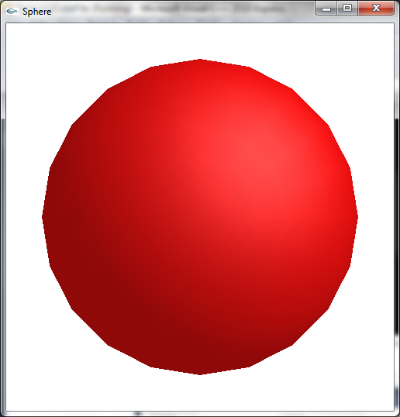
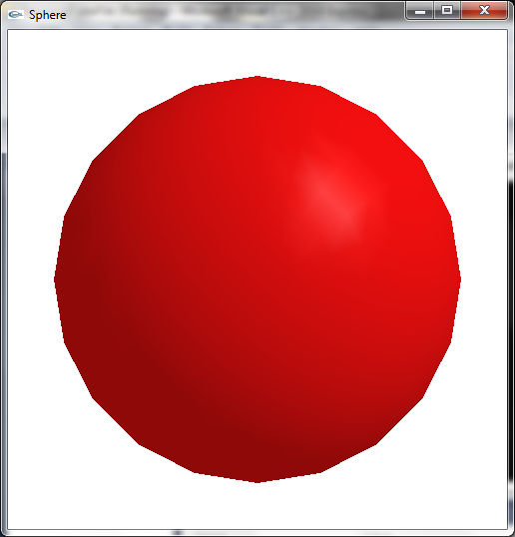
Shininess coefficients
100
10

Slide 24
Emissive light
object materials (not lights) can also include an emissive element
the colour of the light emitted from the object
it doesn’t actually illuminate the scene
unless you place a light at the same position with the same colour

Slide 25
OpenGL lighting calculation
once the lights and object materials are specified, OpenGL calculated the colour of the light reflected from each vertex of the object, for each component
for the ambient component
R = LR * MR G = LG * MG B = LG * MG
the diffuse and specular components also depend on the angle between the light source and the surface
the specular component also takes into account the shininess coefficient
and adds up the components
if a colour component is greater than 1.0, it is clamped at 1.0

Slide 26
Lighting example
solid sphere at origin
light position = {1.0, 1.0, 1.0, 0.0};
the fourth component means it is infinitely far away in this direction
use 1.0 if you want to specify an actual position (point or spot light)
light components
lighting whiteLighting = {
{0.2, 0.2, 0.2, 1.0}, // ambient
{0.7, 0.7, 0.7, 1.0}, // diffuse
{0.5, 0.5, 0.5, 1.0} // specular
};
material components =
material redShinyMaterial = {
{0.80, 0.05, 0.05, 1.0}, //ambient
{0.80, 0.05, 0.05, 1.0}, // diffuse
{1.0, 1.0, 1.0, 1.0}, // specular
100.0 // shininess
};

Slide 27
OpenGL lighting
by default, the lighting model is used to calculate the colour of each vertex
so need to specify the normal at each vertex
smooth shading is used to interpolate between the vertices
the more polygons in the model, the better
if flat shading is used, the colour of the first vertex is used to shade an entire polygon

Slide 28
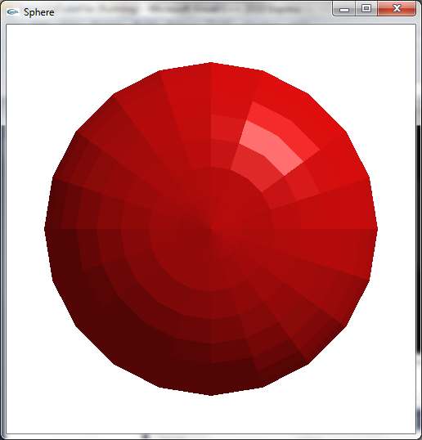
A flat-shaded sphere

Slide 29
Normals
a normal is a vector perpendicular to a surface
can be calculated for a polygon from the vertex coordinates
from the cross product of two vectors
we need the value of the normal at each vertex to calculate the diffuse and specular shading components
calculate a vertex normal by averaging the normals for the polygons which include that vertex
none of this is done by OpenGL

Slide 30
Fortunately
the standard GLUT drawing functions (sphere, teapot, torus…) include vertex normals
sometimes you can work them out from the object geometry
the normals to the vertices of a sphere or cube centered at the origin are vectors pointing from the origin to the vertex
if you create a model in a modelling package, you can export the normals
as well as the vertex and facet information
your program will need to read in and store the normal for each vertex

Slide 31
Transforming normals
OpenGL lighting works with normalised normals
vectors of unit length
translating the model will not change the normals
rotating the model will also rotate the normals, but not change the length
however, scaling the model changes the length of the normals – no longer unit length
need to enable automatic normalisation
glEnable(GL_NORMALIZE);
slow so don’t use unless you are scaling your models

Slide 32
Using lights in OpenGL
to use lights in OpenGL, we need to enable
the lighting
at least one light
glEnable(GL_LIGHTING);
glEnable(GL_LIGHT0);
we can enable up to 8 lights
the default colour for light 0 is white
lights 1-7 are black by default
once we have enabled lighting, calls to glColor*() are ignored
the colour of each pixel is calculated from the interaction of the light(s) and the current material

Slide 33
Using materials in OpenGL
before rendering, need to define the current material
can be used for a single object, several objects, a part of an object….
need to specify the ambient, diffuse, specular and emissive colour of the material
and the shininess coefficient
if not specified, the default values are used
ambient and diffuse colours are often the same so can be specified together

Slide 34
Default material values
Parameter Name | Default Value
GL_AMBIENT | (0.2, 0.2, 0.2, 1.0)
GL_DIFFUSE | (0.8, 0.8, 0.8, 1.0)
GL_AMBIENT_AND_DIFFUSE
GL_SPECULAR | (0.0, 0.0, 0.0, 1.0)
GL_SHININESS | 0.0
GL_EMISSION | (0.0, 0.0, 0.0, 1.0)
by default the material is white, with ambient and diffuse components
no specular highlights (black, coefficient 0)
no emission (black)

Slide 35
Positioning the light
by default, the light position GL_POSITION has the value (0,0,1,0)
same as
glLightfv(GL_LIGHT0, GL_POSITION, light0_pos);
where float light0_pos[] = {0.0, 0.0, 1.0, 0.0};
the final 0 means this is a directional light
imagine it is an infinite distance from the scene
shining along the negative z-axis
remember the light vector points from the scene to the light
specifying a final 1 gives a positional light
for example, a ceiling light
by default it shines in all directions
but can define its cone of illumination
and its attenuation with distance

Slide 36
Summary
This lecture we have
discussed lights and colours
In the practical we will
learn how to specify lights and materials in OpenGL
Create scenes containing multiple 3D GLUT objects
Reading:
OpenGL Programming Guide (The Red Book)
Chapter 5: Lighting
http://glprogramming.com/red/chapter05.html
OpenGL Super Bible
Chapter 9: Lighting and lamps
http://opengl.czweb.org/ch09/261-266.html#Heading1

